Slide 1
DIGITAL PORTFOLIO
Students name : Vinodh.am
Registration no :2422k2171
NMID:4936F9F5DF607F1BDBB4B26DD3B71A4D
College:govt college of arts and science
University: Bharathiyar University

Slide 2
Digital portfolio
A digital portfolio serves as a platform to present creative ideas while also highlights the work and skills of the participant

Slide 3
Agenda:
Problem statement
Project overview
End user
Tools and technologies
Portfolio design and layout
Features and functionality
Result and screenshot
Conclusion
GitHub link

Slide 4
Problem statement
In today's era traditional resumes alone are not enough enough to showcase skills and projects effective.many students fail to showcase their skills of professional experience

Slide 5
Project overview
I created a portfolio that showcase my talents in html , and all the other designing ideas of myself
It contains about myself and the project and the skills that I obtained
The idea is to establish my skills and the project that I have done

Slide 6
End user
The students could take it as a template for their own portfolio
Job seekers who could share their resumes in an interactive ideas
Freelancer who could showcase their previous works to impress their client
Professional who could create their work to the new companies

Slide 7
Tools and technologies
Html to create the basic structure idea of the website and gives preview
Css to create the styling properties of the webpage
Java script to create interactive wed page
Code pen tha online platform for exicuting code

Slide 8
PORTFOLIO DESIGN AND LAYOUT
It includes tha home about me that redirect to the project skill and contact it has responsive layout using the flex that can adapt asper the screen size

Slide 9
FEATURES AND FUNCTIONALITY
Navigation bar with smooth scrolling
Interactive elements (hover, effect, animations
Contact form
Responsive design using flex

Slide 10
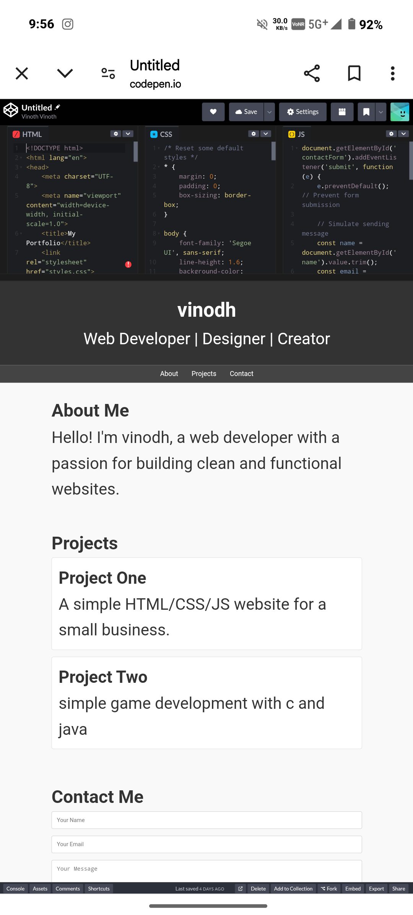
RESULT AND SCREENSHOT

Slide 11
CONCLUSION
The project conclude that every student or work seekers can adapt as per the practical amendment of the technical knowledge which creates a first impressions and create the interview process with ease

